Slide 1
Leadership & Consulting in Data Science
Week 1

Slide 2
Week 1 Agenda
1
2
3
4
Introductions
Course Introduction and Logistics
Data Science Pipeline
Human Skills

Slide 3

Introducing yourself: your body language and voice speak before your words
Introductions
Clients and colleagues form impressions within seconds of an introduction – and most of that first credibility test is nonverbal
Body language
  Posture – stand or sit tall and open; square up to your audience; no slouching, leaning away, or crossed arms
  Eye contact – connect steadily and naturally with the people in the room, not the floor, your notes, or the slides
  Hands – keep them visible and purposeful; use natural gestures to reinforce your words; avoid fidgeting, pockets, or gripping the table
Voice
  Tone – warm, confident, conversational; vary your pitch to stay engaging; end statements with a downward inflection, not a question
  Audibility – project so the farthest person hears you effortlessly; slow down; pause instead of reaching for “um” and “like”
Practice (5 min, pairs)
  Deliver your 30-second introduction twice – first without attention to these techniques, then applying them deliberately. Partner feedback: what changed in how credible and confident you seemed?
Watch: See for yourself how body language and voice make a difference!
Exercise

Slide 4
Week 1 Agenda
1
2
3
4
Introductions
Course Introduction and Logistics
Data Science Pipeline
Human Skills

Slide 5
Leadership and Consulting focuses on skills you need in the “real” world
Course Introduction and Logistics
Organizations increasingly rely on AI and data science to support strategic decision-making, improve operations, and create competitive advantage in ambiguous real-world situations. Successful data scientists must be able to do more than build models—they must understand business problems, lead stakeholders through ambiguity, communicate effectively, collaborate within teams, and guide projects from definition through implementation.
Leadership and Consulting in Data Science develops the business and communication skills required to deliver organizational value through AI and data science. Students learn how to frame business challenges as data science opportunities; gather and interpret information within complex organizational environments; communicate insights persuasively to technical and non-technical audiences; and work effectively within cross-functional teams.
Using a structured data science delivery process, students will apply methodologies and techniques related to problem definition, data collection, modeling, and business impact guided by responsible AI principles. Through case discussions, team-based exercises, and presentations, students will develop leadership and consulting capabilities to become effective, influential, and trusted AI and data science professionals.

Slide 6
Leadership and Consulting has five learning outcomes
Course Introduction and Logistics
After completing this course, students should be able to:
Business Value: Frame organizational and business challenges as AI and data science opportunities that create measurable business value
Communication: Communicate complex analytical findings and influence decision-making through clear storytelling, effective visualization, and executive-level presentations
Teams: Work effectively in cross-functional teams by applying consulting, leadership, interviewing, stakeholder management, and feedback techniques
Process: Execute AI and data science initiatives using a structured process spanning problem definition, data discovery, modeling, business case development, and implementation planning, while applying responsible AI principles
Human Skills: Demonstrate professional effectiveness through self-assessment, goal setting, self-awareness, credibility, and business etiquette

Slide 7
Preparation and participation in the class process is critical for your success
Course Introduction and Logistics
Prior to Class - Preparation
Problem-solving
Domain knowledge
Content (Read/Watch)
Business Problem
Data Exploration & Modeling
Exercises (e.g., Self-Assessments, Questions
for Discussion)
Communication
& presentation
“A successful data science consultant requires of wide ranges of skills”
Pouvan Fard,
Data science circle
Business acumen
Machine learning
During Class – Experience Together
Discuss/Clarify Content
Apply Learning as a Class & Groups
    Problem & Data & Solutions
    Considerations in Consulting
    Internal Processes
    Client Communication
Teamwork
& project management
Big data
Analytical thinking

Slide 8

In this course, you will work within a team
Course Introduction and Logistics
The team effort provides an opportunity to explore communications and strategy in data and analytics (e.g., strategic focus, industry analysis, business frameworks, and business case analysis), to structure and manage teamwork, and to coordinate both orally and in PowerPoint a series of cohesive, well thought out, and easily understood presentations
Teams will need to meet between classes to flesh out and complete the work they begin during class team meetings, cover topics they do not explore in class meetings, and work on their team presentations

Slide 9
Each week, we will discuss topics that drive our understanding and ability to work
Course Introduction and Logistics
 | Topic | Course Outcome | Specific Topic Learning Outcome | Case
1 | Data Science Pipeline | Process | Apply a structured AI and data science delivery process used in this course—from business problem definition through implementation planning.
 | Human Skills | Human Skills | Demonstrated professional effectiveness through self-assessment, goal setting, self-awareness, credibility, and business etiquette.
2 | Business Context | Business Context | Apply fundamental business concepts, organizational strategy, and value creation to help frame data science work in a business context.
 | Feedback (Giving, Receiving, Team) | Human Skills Communications | Practice delivering and receiving constructive feedback that improves performance, strengthens relationships, and supports continuous learning within high-performing teams.
 | Team Foundations (Formation, Dynamics, Conflict) | Teams | Apply the foundational principles of effective teamwork, including team formation, role definition, communication, trust, conflict, and collaboration.
3 | Communications – Decks (Writing, Presenting, Visualizing) | Communications | Communicate analytical insights persuasively through effective storytelling, presentation design, data visualization, and confident delivery tailored to the audience and business context. | McDonalds
4 | Project Management | Process | Apply project management principles to define scope, manage stakeholders, coordinate execution, and deliver successful AI and data science initiatives.
5 | Team Performance (Creativity, Problem Solving, Decision Making) | Teams | Apply collaborative approaches to decision making, creativity, conflict resolution, coaching, and problem solving to improve team performance.
6 | Measurement and Metrics | Business Context | Define and use meaningful metrics to measure project success, business value, and organizational impact | Verizon
 | Meeting Management | Process | Plan, facilitate, document, and follow up on meetings that maximize productivity, engagement, and decision quality.
7
8 | Responsible AI | Human Skills Process | Apply responsible AI principles when developing and deploying AI and data science solutions, including privacy, fairness, transparency, security, regulatory compliance, and bias mitigation.
 | Interview for Info | Human Skills Business Context | Conduct effective stakeholder interviews to gather requirements, understand business problems, and build trusted relationships.
9 | Team Leadership Challenges (Diversity, Dysfunction) | Teams | Lead and contribute to high-performing teams by applying principles of diversity, team performance, coaching, organizational influence, and managing team dysfunction. | Ecommerce
10

Slide 10

Grading focuses on team and individual effort
Course Introduction and Logistics
Category
%
Individual Assignments
20
Quizzes
10
Group Assignments
30
Final Projects
25
Collaboration within Teams
15

Slide 11
Quizzes will check your existing knowledge and then test your learning
Course Introduction and Logistics
A quiz on topics for the week will be taken at the beginning of the class
Quizzes are multiple choice and based on a bank of questions
Checks your previous knowledge
Some pre-read material will help with some of the concepts
You can OPTIONALLY take the quiz a second time before the next class
Improve your overall quiz grade for the week
Tests your learning in the topics based on class discussion and activities
You can add additional material for learning if you desire

Slide 12
Questions?
Course Introduction and Logistics
Homework?
Download data and start it before class
Are class sessions mandatory?
– Yes, request an exception from your professor if you must be absent.
Is there a Final Exam?
No, but an important final project
What if I think the technical model building and machine learning is more important than the business aspects of problems? Well…
Great…hopefully by the end of the class, you may gain some
balanced perspective!!

Slide 13
Week 1 Agenda
1
2
3
4
Introductions
Course Introduction and Logistics
Data Science Pipeline
Human Skills

Slide 14
The Data Science Pipeline will guide our journey through the class
Data Science Pipeline
Define
Collect
Model
Rationalize
Deploy
Understand the situation and the problem
Collect Requirements
Define Scope
Research
Create Problem Statement
Estimated Value
Identify and collect all relevant information to support analysis
Identify Data
    Internal
    External
Obtain Data
  Clean Data
  Explore the Data (EDA)
Research, identify, and build models to solve
the problem
Research Model(s)
Select Model(s)
Build Model(s)
Evaluate Model(s)
Build a clear business case for why the model makes sense
  Clarify Impact (Cost/Benefit)
    NPV
    LTV
Determine Risk & Mitigation Strategies
Create Timeline
    Build
    Pilot
    Deploy
  Identify Team
    Experts
    Consultants
    Operations
Prepare a roadmap
and rollout the model to the organization
Build Roadmap
    Governance
    People
    Process
    Technology
Execute
Document
Manage Change
Operate

Slide 15
You must understand the overall situation and set expectations
Data Science Pipeline - Define
Background and Context
Build a set of background facts, statistics, and review previous research to help understand the context of the problem
Develop the Problem Statement
Clearly and succinctly state the problem you aim to address. Use precise language to describe the issue, avoiding vague or ambiguous terms
Set Scope and Limitations
Define the scope of the problem by specifying what is included and what is excluded. Mention any limitations or constraints that may affect the solution
Understand Impact and Importance
Explain why it's essential to solve this problem. Describe the potential consequences of not addressing it and the benefits of finding a solution

Slide 16
Finding the core business problem and identifying value creation requires business understanding
Data Science Pipeline - Define
Focus on the right business problem is not as easy as it seems on the surface. Key questions help to resolve to the core problem addressable by your consulting team for maximum impact
Challenge
What are the challenges faced by the business today?
Economic Levers
What are the economic levers for impact?
Barriers
What are the barriers in play that stop us from simply resolving the situation?
Gaps
What information gap, if we could address it, would influence each economic lever?
Analytics
What approach matches the problem best – descriptive, predictive, prescriptive?
Influence
Does problem posed by client require refinement, breakdown, expansion, pivot from symptom to root cause, from incremental to breakthrough?

Slide 17
A well-defined problem statement follows a set of rules
Data Science Pipeline - Define
Test | Example Questions
Clear and Concise | The problem statement is clear and easy to understand Does it avoid jargon and technical terms that may be confusing to others? Is the statement concise, expressing the problem in a brief and focused manner Does the problem statement clearly define the issue or challenge you are addressing? Is it specific enough to guide your research or project effectively? Does it avoid vague or overly broad language?
Relevant | The problem statement is relevant to your organization’s goals and/or objectives Does it align with the broader context of your work or organization's mission? Is the problem statement timely and significant in the current context? Is the problem statement realistically solvable within the available resources, time, and constraints? Have you considered potential barriers and challenges in addressing the problem?
Impactful | Solving the problem will make a difference Have you considered the potential benefits and consequences of addressing this problem? Can you identify specific criteria or metrics to measure the extent of the problem or its impact? Does the problem statement allow for quantifiable assessment and evaluation?
Appropriate Perspective | The problem statement reflects the interests and concerns of key stakeholders Have you considered the perspectives and needs of relevant stakeholders, including end-users or those affected by the problem?

Slide 18
“Good” problem statements help you see what is trying to be accomplished
Data Science Pipeline - Define
Increase sales by identifying the factors that
influence customer behavior
Develop a model to accurately forecast energy consumption at a granular level (household or community) within a smart grid, facilitating more efficient energy distribution and contributing to the reduction of peak energy demand
Understand the relationship between air pollution and respiratory diseases
Identify patterns and anomalies in the operational efficiency of healthcare providers to suggest improvements that could enhance patient care and reduce waiting times by analyzing patient flow, staff allocation, and treatment outcomes
Determine the key factors contributing to customer churn at a telecommunications company and develop a predictive model that accurately identifies high-risk customers within the next billing cycle, enabling targeted customer retention strategies
Could any of these be written better? How?
Monitor and analyze the sentiment of social media
mentions related to our brand to gauge public perception, identify emerging trends, and respond to customer feedback more effectively, aiming to improve customer satisfaction scores by 10%
Develop an automated system to detect potentially fraudulent transactions in real-time, reducing the incidence of fraud by 30% within the first year of implementation, without significantly increasing the false positive rate
Analyze the current supply chain network to identify inefficiencies and bottlenecks that contribute to delays and increased costs, and propose data-driven solutions to optimize the flow of goods from suppliers to distribution centers

Slide 19
Creating a well-defined problem statement is critical to solving the problem
Data Science Pipeline - Define
As a group, select one of these options:
Build a Consumer Offer Model that is Better than Existing Logistic Regression for Verizon
Turn-around Declining Revenue on Flagship Product Line for 3M
Increase volume for consumer product brand without discounting price
Increase forecast accuracy of revenue and earnings per share for portfolio companies
Increase economic impact of data science team
Create a well-developed problem statement
Present your problem statement to the class
Exercise

Slide 20
Data comes in a wide variety of sizes, dimensions, packages, and structures
Data Science Pipeline - Collect
Some say that unstructured data is data just waiting for a structure. Also, data has many levels of granularity, degrees of quality, and challenges that require innovative thinking before it is possible to extract value.
Data Dimensions Increasing in Size of Source
What other data characteristics can be used to dimensionalize and size data assets?
Type
Time
Consumer
  Numbers
  Text
  Location
  Video
  Complex Content
  Aggregated Historical
  Annual
  Quarterly
  Hourly
  Granular Real-time
  Attitude
  Motivation
  Intent
  Advocacy
  Purchase Behavior

Slide 21
There are five key steps in data collection
Data Science Pipeline - Collect
Assess data & objectives
Determine what you have, what you need and why
Identify sources,
formats & volume
Internal systems, APIs, IoT devices, web & social media
Define purpose & comply with laws
Align collection with objectives, respect GDPR, HIPAA, etc.
Automate &
ensure relevance
Leverage ETL tools, streaming pipelines & validate data quality
Test, document & secure
Pilot your methods, document metadata, apply access controls & backups

Slide 22
Data to address a situation can extend beyond obvious sources
Data Science Pipeline - Collect
The data immediately available may lack structure suitable for modeling and may violate key assumptions of statistical approaches
In many situations, the problem posed has remained unsolved due to a lack of expanded thinking regarding the universe of data
Expand the
data universe dramatically!
  Consider both internal and external data sources
  Design an experiment to derive robust model coefficients if needed
  Consider competitive intelligence as well as competitive data/benchmarks
  Purchase data to augment “free” sources and improve performance
  Identify an untapped research and data method to augment data sources
  Make sure to include: primary, secondary, qualitative, quantitative, behavioral, demographic/psychographic, attitudinal, intent, location, IOT, device, credit, health, lifestyle and product usage?

Slide 23
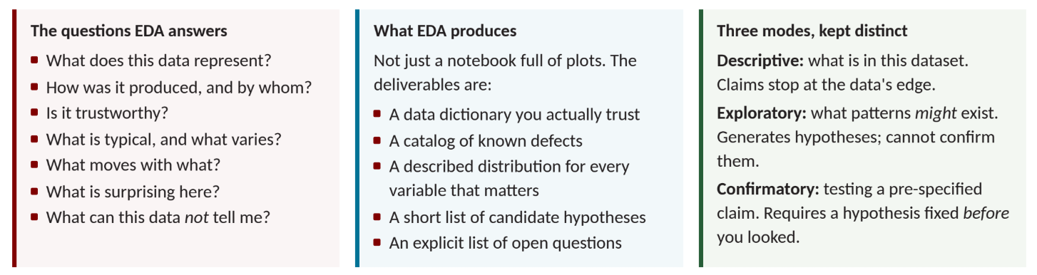
Use Exploratory Data Analysis (EDA) to describe, question, and understand data
Data Science Pipeline - Collect
See the “EDA Cheat Sheet – Claude” on Canvas for details

Slide 24
Consider best practices & ethics when collecting the data
Data Science Pipeline - Collect
Align
with purpose
Maintain
data quality
Protect privacy
& fairness
Secure
& govern
Collect only what is needed for the business question
Standardize formats, use metadata & monitor for drift
Obtain consent, anonymize data and guard against bias
Implement access controls, backups and audit trails

Slide 25


The Main Points
Data Science Pipeline - Model
Take what you’ve learned from the Data Science Pipeline so far
The Business Problem and Value
Data Universe
Understand the factors that influence
model selection
Design the Model Methodology

Slide 26

Match the Problem & Solution Options
Data Science Pipeline - Model
Design and Develop the analytic approach to
the problem – given problem understanding
and data

Slide 27
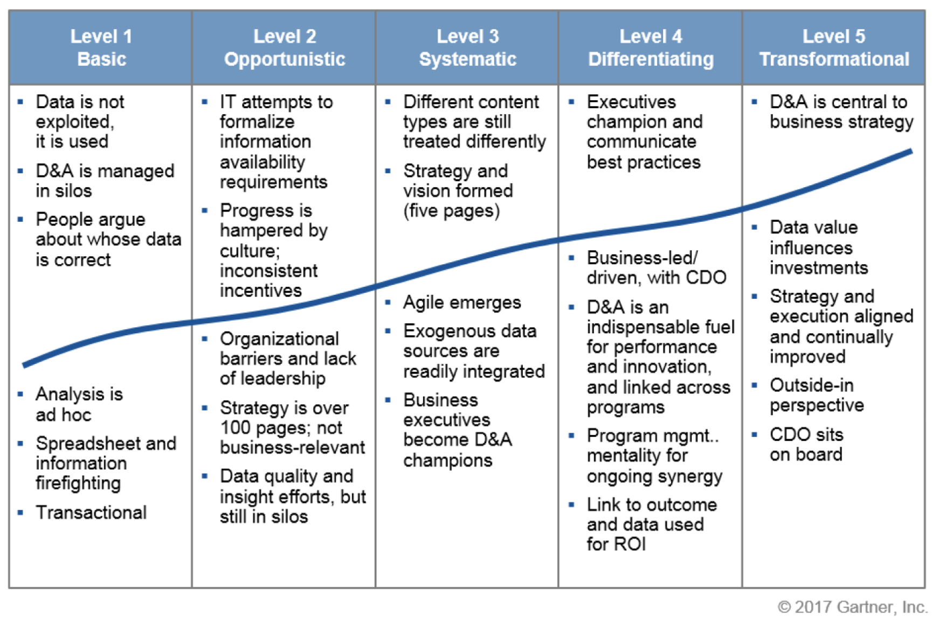
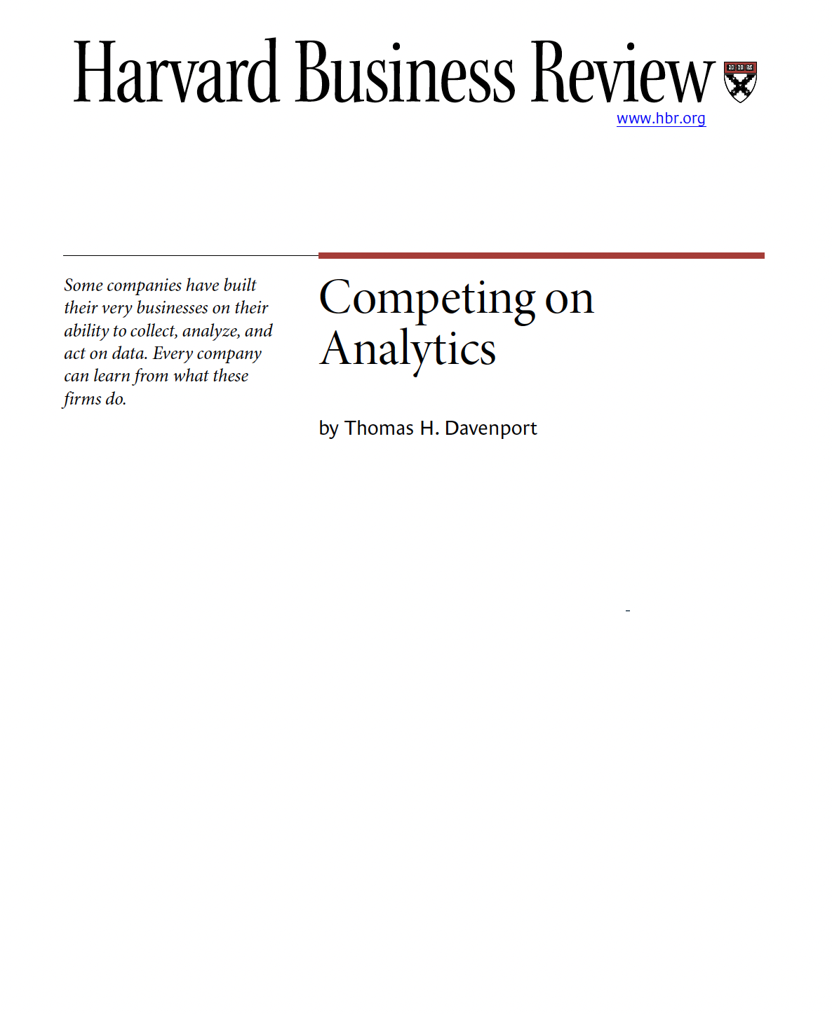
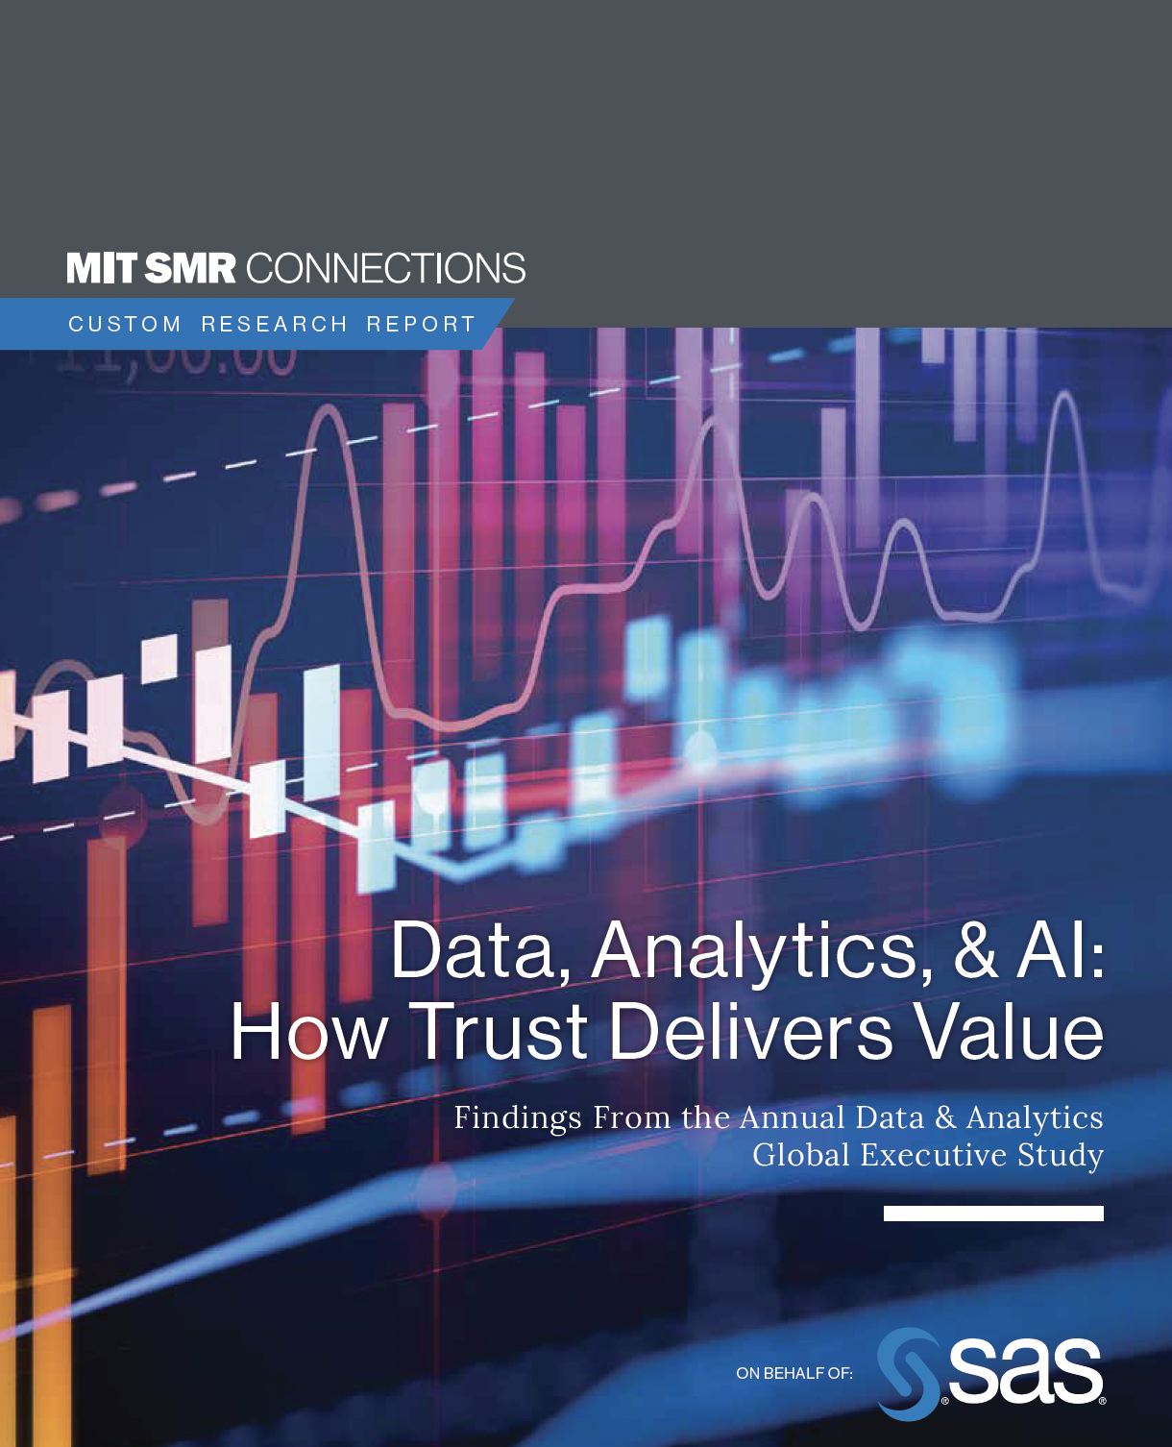
‘Other Key Factors’
Data Science Pipeline - Model
Time
Example Stages of Client Analytic Maturity
Scope Agreement & Management
Life Cycle View or
Next Stage
Client Analytic Maturity

Slide 28
Further details on popular machine learning algorithms and their applications
Data Science Pipeline - Model
Machine Learning Types
Supervised Learning
Unsupervised Learning
Semi-supervised Learning
Reinforcement Learning
Continuous Target Variable
Categorical Target Variable
Target variable
not available
Categorical
Target Variable
Categorical Target Variable
Target variable not available
Regression
Classification
Clustering
Association
Classification
Clustering
Classification
Control
Housing Price Prediction
Medical
Imaging
Customer Segmentation
Market Basket Analysis
Text Classification
Lane-finding on GPS data
Optimized Marketing
Driverless
Cars
Linear regression, logistic regression, Naïve Bayes, Neural networks, Decision Trees, Support Vector Machines etc
Clustering, anomaly detection,
self-organizing maps,
expectation-max. alg., Principal component analysis etc
Support vector machines, generative models, graph-based models, heuristic approaches etc
Markov decision process, monte carlo methods, Q-learning, deep adversarial networks etc

Slide 29
Prepare by putting yourself in the right frame of mind
Data Science Pipeline - Rationalize
Identify Stakeholders
Identify
Business Need
Consider Alternatives
Identify
Appropriate
Subject Matter
Experts (SMEs)
Identify
Who Benefits

Slide 30
Estimate the costs and benefits
Data Science Pipeline - Rationalize
Project costs
Consider using something like…
Project expenditures
Capital expenditures
Ignore
Sunk
Costs
Costs
Benefits
Operating costs and benefits
Manage
Uncertainty
Tangible
Revenues
Cost avoidance
Productivity savings
Get the
numbers
(track the
origin)
Intangible costs and benefits
Intangible
Morale
Strategic impact
Competitive impact

Slide 31
Financial Impact is important…Net Present Value (NPV) is often used
Data Science Pipeline - Rationalize
ROI = Net Benefit/Total Cost
Method | Answers the question… | Expressed in… | Typically used for…
Breakeven Analysis | Quantity - How many sales do we need to recoup the investment? | Units sold | Market-focused projects, such as product development; entrepreneurial endeavors
Payback Period | Liquidity - How long will it take to recoup the investment? | Months or years | Projects with a heavy upfront investment, such as facilities projects; productivity projects that accumulate benefits over time. Companies with liquidity constraints may prioritize this over longer-term higher NPV choice
Net Present Value (NPV) | Profitability - How much is this project worth to the business? | Dollars | Determining overall project profitability and comparing mutuall yexclusive projects, typically with large expenditures
Internal Rate of Return (IRR) | Rate of return - What rate of return will this project deliver over its lifecycle? | Percentage | Projects that the company reports on externally, especially those that require you to borrow money. Useful when cash flows are not linear
Detail follows

Slide 32
A Roadmap lays out the work required to deliver the Data Science Solution
Data Science Pipeline - Deploy
Legend
Ongoing Activities
Ongoing Activities
 | CY 2016 |  |  |  |  | CY 2017 |  |  |  | CY 2018 |  |  |  | …
Initiative | Q4 | Q1 | Q2 | Q3 | Q4 | Q1 | Q2 | Q3 | Q4 | Q1 | Q2 | Q3 | Q4
1. Initial Central Analytics Deployment
2. Enterprise and Local Analytics Team Enablement
3. Governance Overhaul
4. Analytics Quality and Usability
5. Initial Data Standardization
6. Improved Data Integration
7. Improved Access, Transparency and Discovery
8. Enablement of Core Enterprise Pop. Health Capabilities
9. Self Service Enablement
10. Core Data and Analytics Delivery Enhancements
11. Enterprise Patient/Member Analytics Deployment
12. Enterprise Innovation Enablement
13. Real-time Surveillance and Analytics
14. Care Coordination/Care Management Enablement
15. Inclusion of Non-Standard 3rd Party Data
16. EA Vision and Strategy Refresh
Analytics Operations and Management deployed under CAO
Local Analytics Teams Deployed, Performance Analytics deployed under CAO (Decision Support, Clinical/Quality)
Phase 1
CAO Deployed
Improved data integration and data quality
Enterprise Population Health capabilities and competencies deployed
Improved data access, usability and discoverability
Phase 2
Broad analytics tool enhancement and NoSQL deployed
Enterprise self-service capabilities deployed
Enterprise Patient/Member Analytics Group and Innovation Lab Operation
Phase 3
Real-time complex events processing (CEP) deployed and integrated into clinical and business workflow

Slide 33
Rollout the solution across the organization based on the Roadmap
Data Science Pipeline - Deploy
Integration
Automation
Testing

Slide 34
Documentation will be needed to support the Data Science Solution
Data Science Pipeline - Deploy
Documentation
Technical Documentation
Document the architecture, algorithms, and methodologies used in the data science project
User Manuals
Create detailed user manuals and guides for end-users to understand how
to interact with the data science applications
Maintenance Guides
Provide documentation for system administrators on how to maintain and troubleshoot the system
Compliance and Security Documentation
Ensure all compliance requirements are documented, including data privacy
and model governance protocols

Slide 35
The Data Science solution needs to be operated appropriately
Data Science Pipeline - Deploy
Monitoring Systems
Set up monitoring systems to track performance of the data science models and their impact on business processes
Performance Optimization
Continuously monitor and tweak the system for optimal performance
Security Measures
Implement robust security measures to protect data and model integrity
Disaster Recovery Plan
Develop a comprehensive disaster recovery plan to ensure system resilience and data protection.

Slide 36
Week 1 Agenda
1
2
3
4
Introductions
Course Introduction and Logistics
Data Science Pipeline - Define
Human Skills

Slide 37
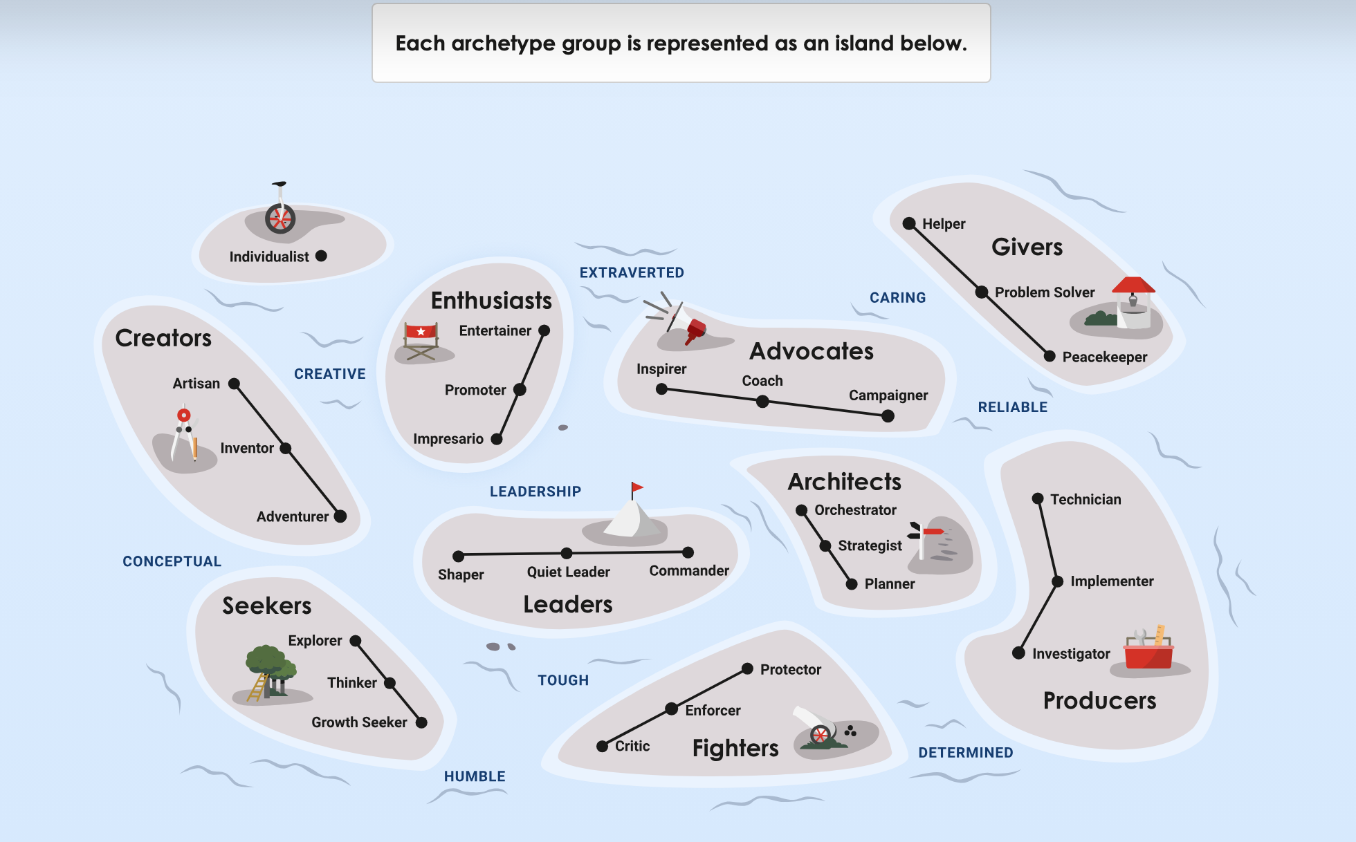
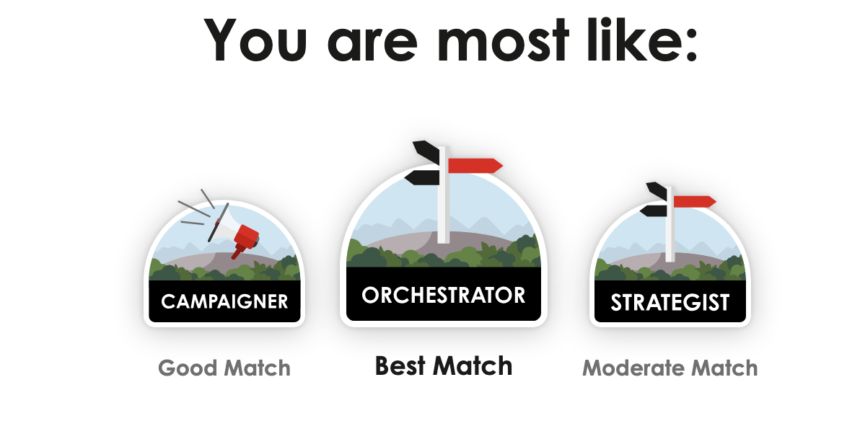
The PrinciplesYou Survey identifies your “Archetype” in a “Group”
Human Skills – Self-Assessment
Example Results:
What are your dominate archetypes?
How you prefer to think
How you engage with others
How you apply yourself
How you respond in different situations

Slide 38
Each Archetype allows you to understand how you work and work with others (1 of 2)
Human Skills – Self-Assessment
Group | Archetype | Short Description
Advocates | Inspirer | Inspirers motivate people to get behind challenging, important ideas and goals; work without a meaningful mission drains them.
 | Coach | Coaches see growth and learning as central to life and model them for others; watching potential go to waste frustrates them.
 | Campaigner | Campaigners rally others around ideas and solutions to get practical results; indifference to causes that matter drains them.
Architects | Orchestrator | Orchestrators bring people together and mobilize resources to exceed expectations; scattered, uncoordinated effort frustrates them.
 | Strategist | Strategists turn concepts and ideas into effective strategies for results; action taken without a clear plan makes them impatient.
 | Planner | Planners put structure and systems around goals to make them achievable; ambiguity and shifting targets wear them down.
Creators | Artisan | Artisans use creativity to bring beautiful, well-crafted ideas to life; work that values speed over craft drains them.
 | Inventor | Inventors love generating new and innovative ideas, products, and solutions; convention and routine quickly bore them.
 | Adventurer | Adventurers are energized by fun, exciting, and novel pursuits; predictable routine leaves them restless.
Enthusiasts | Entertainer | Entertainers create engaging experiences and connect with the people around them; overly reserved settings drain them.
 | Promoter | Promoters use outgoing, charismatic people skills to advance shared causes; long stretches of solo work drain them.
 | Impresario | Impresarios love engaging socially and facilitating great shared experiences; isolation leaves them flat.
Fighters | Critic | Critics freely express opinions and love debating different perspectives; avoiding hard questions to keep the peace frustrates them.
 | Enforcer | Enforcers rely on standards, rules, and traditions; unclear or unevenly applied expectations frustrate them.
 | Protector | Protectors uphold rules and standards out of a strong sense of duty; careless treatment of commitments drains them.

Slide 39
Each Archetype allows you to understand how you work and work with others (2 of 2)
Human Skills – Self-Assessment
Group | Archetype | Short Description
Givers | Helper | Helpers are driven by care and compassion for others and their needs; cold, purely transactional environments drain them.
 | Problem Solver | Problem Solvers support others in an industrious, professional way; unresolved issues are hard for them to ignore.
 | Peacekeeper | Peacekeepers build positive relationships and seek harmony and compromise; constant friction between people exhausts them.
Individualists | Individualist | Individualists walk to the beat of their own drum and express originality; pressure to conform wears on them.
Leaders | Commander | Commanders drive goals through determination and high standards; indecision and low accountability test their patience.
 | Quiet Leader | Quiet Leaders guide others with open-mindedness and composure under pressure; drama and showmanship wear on them.
 | Shaper | Shapers set ambitious goals and push relentlessly to make them happen; small thinking and slow progress frustrate them.
Producers | Investigator | Investigators research and analyze information and data to build understanding; decisions made on gut feel alone frustrate them.
 | Implementer | Implementers structure people and processes to execute tasks reliably; plans that keep changing mid-execution drain them.
 | Technician | Technicians break down, analyze, and solve problems in a practical, technical way; vague solutions leave them unsatisfied.
Seekers | Explorer | Explorers love taking in new knowledge and seeking out new experiences; staying in a narrow lane too long drains them.
 | Thinker | Thinkers approach problems abstractly and search for deeper meaning; cultures of acting before thinking wear them down.
 | Growth Seeker | Growth Seekers have a deep passion for learning and personal development; environments with no room to grow stall them.

Slide 40
Good goals have two key attributes
Human Skills – Goal Setting
Everyone should have personal and professional goals – and setting goals is part of being in an organization
Measurable
  Your goal should have an objective – a key performance indicator (KPI) – that makes clear what you are trying to achieve
  It can be a specific number, a percentage change, or another measurable element
  “Reduce” or “improve” is not measurable unless it is followed by a specific number
Time-Based
  Your goal should have an end date – a specific deadline provides the sense of urgency every goal needs
  “In 2 hours,” “in 5 days,” “in 6 weeks,” “end of Q1,” “by my birthday,” and “end of the year” all work

Slide 41
Examples of data science goals
Human Skills – Goal Setting
Each example below has a KPI and a deadline – test every goal you write against both attributes
  Achieve a 30% reduction in data cleaning time per project by the end of Q1
  Increase model accuracy from 85% to 90% by the end of March
  Increase 2025 collaboration by hosting monthly knowledge-sharing sessions to align cross-functional teams on key metrics and goals
  Build and deploy an ML model that predicts sales trends based on historical data by the end of Q2
  Dedicate 4 hours per week over the next 2 months to improve my data visualization skills by taking two online courses

Slide 42
SMART goals: focus on the M and the T
Human Skills – Goal Setting
SMART (Specific, Measurable, Attainable, Relevant, Time-Based) is a goal-setting methodology many organizations use
Recommendation
  Don’t use the full SMART framework unless your organization requires it
  It is more effective to focus on the M (Measurable) and the T (Time-Based) attributes – they do most of the work
Source
  Manager Tools summarizes this thinking in their Goal Setting podcast: “How to Set Annual Goals” (manager-tools.com/2007/12/how-set-annual-goals-part-1)

Slide 43
Make goal setting an organizational process, not a solo exercise
Human Skills – Goal Setting
Beyond defining your own goals, two practices should be part of the process in your organization – although not every organization does them:
Share and review previous goals
  Look back before looking forward: what was achieved, what slipped, and why
Compare (and adjust) goals with others
  Align your goals with your team and across the organization – comparison surfaces conflicts, gaps, and opportunities to support each other
Discussion: which of these two practices does your organization (or program team) actually do – and what would change if it did both?

Slide 44
Additional resources on SMART goals
Human Skills – Goal Setting
Given the prevalence of SMART goals, these guides provide additional information – but remember to focus on the M and the T:
  Asana – SMART Goals (asana.com/resources/smart-goals)
  Wrike – SMART Goals: An Ultimate Guide with Examples (wrike.com/goal-setting-guide/smart-goals-an-ultimate-guide-with-examples)
  ClickUp – How to Write Effective SMART Goals (clickup.com/blog/smart-goals)
  Smartsheet – How to Write SMART Goals (smartsheet.com/blog/essential-guide-writing-smart-goals)
  Manager Tools – Goal Setting podcast (manager-tools.com)

Slide 45
Self-awareness means understanding your patterns, especially under pressure
Human Skills – Self-Awareness
52% of surveyed employers identify motivation and self-awareness as a core workforce skill. Source: World Economic Forum, Future of Jobs Report 2025, Figure 3.3, “Core skills in 2025.”
To be self-aware means:
Self-awareness is more than knowing your personality type, it is recognizing how your behavior affects other people
Know your strengths. What do people consistently rely on you for?
Know your overused strengths. When does confidence become dominance, analysis become overthinking, or urgency become impatience?
Know your triggers. What situations make you defensive, frustrated, overly quiet, or overly assertive?
Know your impact. Your intention and other people’s experience of you are not always the same
Strong consultants notice these patterns early enough to adjust their behavior
Choose one of your PrinciplesYou strengths. How could that same strength work against you if you overused it?

Slide 46
Self awareness is a requirement for successful engagements
Human Skills – Self-Awareness
Self awareness is a prerequisite for professionalism, adaptability & emotional intelligence, and
successful consulting engagements depend on all of these
Strong consultants
  Solve problems under uncertainty and remain adaptable when requirements change, data quality issues emerge, sponsors shift priorities, and deadlines move
  Remain calm under pressure; accept constructive feedback; handle ambiguity confidently; demonstrate accountability; adapt when scope changes; respect different personalities and working styles
Emotional intelligence includes
  Self-awareness, empathy, professional confidence, conflict management, resilience
Consultants who stay flexible, composed, and solution-oriented become trusted advisors rather than temporary technical resources

Slide 47
Build a self-awareness loop: Notice → Check → Adapt
Human Skills – Self-Awareness
NOTICE
Recognize your initial reaction: assumptions, emotions, tone, pace, body language, or urge to respond immediately.
CHECK
Ask yourself:
What am I assuming?
Am I reacting to the issue or to how the issue was delivered?
What does this person actually need from me?
How might my response be interpreted?
ADAPT
Deliberately adjust your tone, communication channel, level of detail, pace, or approach.
After the interaction:
  What worked?
  What did I contribute to the situation?
  What would I do differently next time?

Slide 48
Technical skills get you hired; human skills earn credibility and client trust
Human Skills – Credibility
Successful consultants spend as much time managing people, expectations, and communication as they do building models. Clients rarely remember who wrote the best Python code – they remember who helped them make better decisions
Critical consulting skills for building credibility
  Executive communication
  Active listening & discovery
  Stakeholder management
  Become a trusted advisor
Discussion: think of a technically excellent project you have seen fail – which of these critical consulting skills was missing?

Slide 49
Executive communication: translate complexity into business value
Human Skills – Credibility
Executives care about outcomes, not algorithms. Say it in their language:
  “Transformer model” → “AI system that improves prediction accuracy”
  “Feature engineering” → “Preparing data to improve decision quality”
  “Precision and recall” → “Reducing costly mistakes”
  “Embeddings” → “Better understanding customer information”
  “Vector database” → “Faster retrieval of relevant knowledge”
Great consultants
  Use simple language; tell stories with data; present recommendations, not just analysis; connect every technical decision to business value; tailor the message – methodology for data scientists, implementation for engineers, risk/cost/ROI/timeline for executives

Slide 50
Active listening & discovery: understand the real problem first
Human Skills – Credibility
Clients frequently describe symptoms, not root problems. A chatbot request may reflect poor knowledge management; a forecasting request may stem from inconsistent master data
Effective discovery behaviors
  Listen more than you speak; ask open-ended questions; clarify assumptions; identify pain points; understand business goals; recognize political and organizational constraints
Five questions that uncover the real problem
  What decision are you trying to improve?
  How is success measured?
  What happens if nothing changes?
  Who will use these insights?
  What data do you trust today?

Slide 51
Stakeholder management: projects succeed when people adopt them
Human Skills – Credibility
A technically perfect solution that nobody trusts or adopts is a failed project. Success depends as much on relationship management as on implementation.
Know your stakeholder map: Executive sponsors, business leaders, subject matter experts, data engineers, IT & security, legal & compliance, end users – each with different objectives, concerns, incentives, and influence
What successful consultants do: Build trust early; manage expectations continuously; resolve conflicts diplomatically; balance competing priorities; keep stakeholders informed throughout – not just at kickoff and delivery
Connect to the DSP: this is why Deploy-stage change management starts in Define

Slide 52
Becoming a trusted advisor
Human Skills – Credibility
Clients hire consultants for expertise. They retain consultants because they trust them
The trusted advisor mindset
  Understand the business first
  Communicate with clarity
  Build relationships intentionally
  Deliver what you promise
  Admit what you don’t know
  Continuously learn and improve
The best AI consultant is not the one who builds the most sophisticated model – it is the one who helps people make better decisions with confidence

Slide 53
Business etiquette is about reducing friction for everyone around you
Human Skills – Business Etiquette
Professionalism is often judged through small, repeated behaviors, not one major interaction
Respect people's time
Be on time and prepared
Meet deadlines or communicate early when you cannot
Do not make others chase you for updates
Respect people's attention
Be concise
Know when a meeting is necessary and when it is not
Put the phone away when someone is speaking to you
Respect the context
Match your communication, dress, formality, and level of detail to the client and situation
Learn team and client norms rather than assuming your preferences are universal
Be especially thoughtful across cultures, generations, and time zones
Respect commitments
Do what you said you would do
Own mistakes quickly
Never let someone discover a problem you already knew about

Slide 54
End of Deck

